Slide 1
Object Oriented Software Engineering (OOSE)
22CS017
Introduction to Software Testing
Prepared By:
Vijaita Kashyap

Slide 2
Index
Software Testing
Importance of Software Testing
Need of Software Testing
Types of Software Testing
Unit Testing
Practice Questions

Slide 3
Software Testing
Software Testing is a method to assess the functionality of the software program. The process checks whether the actual software matches the expected requirements and ensures the software is bug-free. The purpose of software testing is to identify the errors, faults, or missing requirements in contrast to actual requirements.
It mainly aims at measuring the specification, functionality, and performance of a software program or application.
Software testing can be divided into two steps:
Verification: It refers to the set of tasks that ensure that the software correctly implements a specific function. It means “Are we building the product right?”.
Validation: It refers to a different set of tasks that ensure that the software that has been built is traceable to customer requirements. It means “Are we building the right product?”.

Slide 4
Importance of Software Testing:
Defects can be identified early: Software testing is important because if there are any bugs they can be identified early and can be fixed before the delivery of the software.
Improves quality of software: Software Testing uncovers the defects in the software and fixing them improves the quality of the software.
Increased customer satisfaction: Software testing ensures reliability, security, and high performance which results in saving time, costs, and customer satisfaction.
Helps with scalability: Software testing type non-functional testing helps to identify the scalability issues and the point where an application might stop working.
Saves time and money: After the application is launched it will be very difficult to trace and resolve the issues, as performing this activity will incur more costs and time. Thus, it is better to conduct software testing at regular intervals during software development.

Slide 5
Need for Software Testing
Software bugs can cause potential monetary and human loss. There are many examples in history that clearly depicts that without the testing phase in software development lot of damage was incurred. Below are some examples:
1985: Canada’s Therac-25 radiation therapy malfunctioned due to a software bug and resulted in lethal radiation doses to patients leaving 3 injured and 3 people dead.
1994: China Airlines Airbus A300 crashed due to a software bug killing 264 people.
1996: A software bug caused U.S. bank accounts of 823 customers to be credited with 920 million US dollars.
1999: A software bug caused the failure of a $1.2 billion military satellite launch.
2015: A software bug in fighter plan F-35 resulted in making it unable to detect targets correctly.
2015: Bloomberg terminal in London crashed due to a software bug affecting 300,000 traders on the financial market and forcing the government to postpone the 3bn pound debt sale.
Starbucks was forced to close more than 60% of its outlet in the U.S. and Canada due to a software failure in its POS system.
Nissan cars were forced to recall 1 million cars from the market due to a software failure in the car’s airbag sensory detectors.

Slide 6
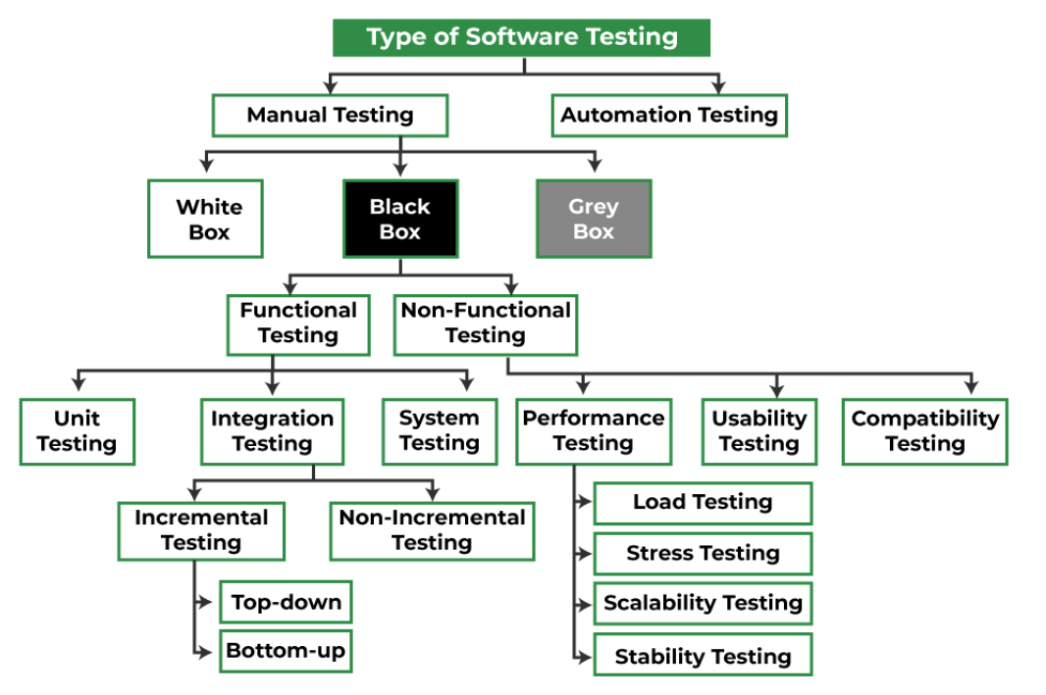
Different Types of Software Testing
Figure 1: Types of Software Testing

Slide 7
Manual vs. Automated testing
Apart from the above classification software testing can be further divided into 2 more ways of testing:
Manual testing : It includes testing software manually, i.e., without using any automation tool or script. In this type, the tester takes over the role of an end-user and tests the software to identify any unexpected behavior or bug. There are different stages for manual testing such as unit testing, integration testing, system testing, and user acceptance testing. Testers use test plans, test cases, or test scenarios to test software to ensure the completeness of testing. Manual testing also includes exploratory testing, as testers explore the software to identify errors in it.
Automation testing : It is also known as Test Automation, is when the tester writes scripts and uses another software to test the product. This process involves the automation of a manual process. Automation Testing is used to re-run the test scenarios quickly and repeatedly, that were performed manually in manual testing.

Slide 8
Different Types of Software
Testing Techniques
Software testing techniques can be majorly classified into two categories:
Black box Testing : Testing in which the tester doesn’t have access to the source code of the software and is conducted at the software interface without any concern with the internal logical structure of the software known as black-box testing.
White box Testing : Testing in which the tester is aware of the internal workings of the product, has access to its source code, and is conducted by making sure that all internal operations are performed according to the specifications is known as white box testing.
Grey Box Testing : Testing in which the testers should have knowledge of implementation, however, they need not be experts.

Slide 9
Difference Between Black, White and Grey box testing
S No. | Black Box Testing | White Box Testing | Grey Box Testing
1 | Internal workings of an application are not required. | Knowledge of the internal workings is a must. | The Gray Box Testing is a combination of Black Box and White Box Testing
2 | Also known as closed box/data-driven testing. | Also known as clear box/structural testing. | The internal structure is partially known in Gray Box Testing.
3 | End users, testers, and developers. | Normally done by testers and developers. | This includes access to internal data structures and algorithms to design the test cases.
4 | This can only be done by a trial and error method. | Data domains and internal boundaries can be better tested. | It is based on requirement test case generation because it has all the conditions presented before the program is tested.

Slide 10
Black Box Testing
Black Box Testing can be broadly classified into 2 types:
Functional testing : It is a type of software testing that validates the software systems against the functional requirements. It is performed to check whether the application is working as per the software’s functional requirements or not. Various types of functional testing are Unit testing, Integration testing, System testing, Smoke testing, and so on.
Non-functional testing : It is a type of software testing that checks the application for non-functional requirements like performance, scalability, portability, stress, etc. Various types of non-functional testing are Performance testing, Stress testing, Usability Testing, and so on.

Slide 11
Different Levels of Software Testing
Software level testing can be majorly classified into 4 levels:
Unit testing : It a level of the software testing process where individual units/components of a software/system are tested. The purpose is to validate that each unit of the software performs as designed.
Integration testing : It is a level of the software testing process where individual units are combined and tested as a group. The purpose of this level of testing is to expose faults in the interaction between integrated units.
System testing : It is a level of the software testing process where a complete, integrated system/software is tested. The purpose of this test is to evaluate the system’s compliance with the specified requirements.
Acceptance testing : It is a level of the software testing process where a system is tested for acceptability. The purpose of this test is to evaluate the system’s compliance with the business requirements and assess whether it is acceptable for delivery.

Slide 12
What is unit testing?
Unit testing is the process of testing the smallest parts of your code, like individual functions or methods, to make sure they work correctly. It’s a key part of software development that improves code quality by testing each unit in isolation.
You write unit tests for these code units and run them automatically every time you make changes. If a test fails, it helps you quickly find and fix the issue. Unit testing promotes modular code, ensures better test coverage, and saves time by allowing developers to focus more on coding than manual testing.
What is a unit test?
A unit test is a small piece of code that checks if a specific function or method in is an application works correctly. It will work as the function inputs and verifying the outputs. These tests check that the code work as expected based on the logic the developer intended.

Slide 13
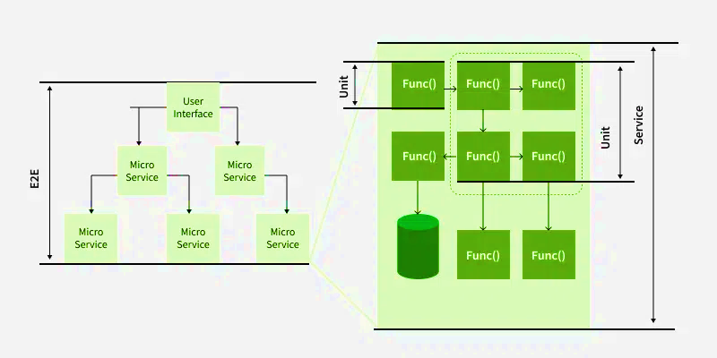
Unit Test
Figure 2. Unit Test

Slide 14
Unit Test
Conti…
Figure 2 shows that these multiple tests are written for a single function to cover different possible scenarios and these are called test cases. While it is ideal to cover all expected behaviors, it is not always necessary to test every scenario.
Unit tests should run one by one, it means that they do not depend on other system parts like databases or networks. Instead, data stubs can be used to simulate these dependencies. Writing unit tests is easiest for simple, self-contained code blocks.

Slide 15
Unit testing strategies
To create effective unit tests, follow these basic techniques to ensure all scenarios are covered:
Logic checks: Verify if the system performs correct calculations and follows the expected path with valid inputs. Check all possible paths through the code are tested.
Boundary checks: Test how the system handles typical, edge case, and invalid inputs. For example, if an integer between 3 and 7 is expected, check how the system reacts to a 5 (normal), a 3 (edge case), and a 9 (invalid input).
Error handling: Check the system properly handles errors. Does it prompt for a new input, or does it crash when something goes wrong?
Object-oriented checks: If the code modifies objects, confirm that the object’s state is correctly updated after running the code.

Slide 16
Unit testing advantages
Early Detection of Issues: Unit testing allows developers to detect and fix issues early in the development process before they become larger and more difficult to fix.
Improved Code Quality: Unit testing helps to ensure that each unit of code works as intended and meets the requirements, improving the overall quality of the software.
Increased Confidence: Unit testing provides developers with confidence in their code, as they can validate that each unit of the software is functioning as expected.
Faster Development: Unit testing enables developers to work faster and more efficiently, as they can validate changes to the code without having to wait for the full system to be tested.
Better Documentation: Unit testing provides clear and concise documentation of the code and its behavior, making it easier for other developers to understand and maintain the software.
Facilitation of Refactoring: Unit testing enables developers to safely make changes to the code, as they can validate that their changes do not break existing functionality.
Reduced Time and Cost: Unit testing can reduce the time and cost required for later testing, as it helps to identify and fix issues early in the development process.

Slide 17
Unit testing disadvantages
Time and Effort: Unit testing requires a significant investment of time and effort to create and maintain the test cases, especially for complex systems.
Dependence on Developers: The success of unit testing depends on the developers, who must write clear, concise, and comprehensive test cases to validate the code.
Difficulty in Testing Complex Units: Unit testing can be challenging when dealing with complex units, as it can be difficult to isolate and test individual units in isolation from the rest of the system.
Difficulty in Testing Interactions: Unit testing may not be sufficient for testing interactions between units, as it only focuses on individual units.
Difficulty in Testing User Interfaces: Unit testing may not be suitable for testing user interfaces, as it typically focuses on the functionality of individual units.
Over-reliance on Automation: Over-reliance on automated unit tests can lead to a false sense of security, as automated tests may not uncover all possible issues or bugs.
Maintenance Overhead: Unit testing requires ongoing maintenance and updates, as the code and test cases must be kept up-to-date with changes to the software.

Slide 18
Practice Questions
What are the types of Software testing?
What is difference between Unit testing and functional testing?
Give the real time scenario where unit testing is used?
Explain the difference between functional testing and non-functional testing.
What is the purpose of test cases and test scenarios?
What is a defect, and how do you report it effectively?
What is the difference between manual testing and automated testing?

Slide 19
Bibliography
https://www.geeksforgeeks.org/software-testing-basics/
https://www.techtarget.com/searchsoftwarequality/definition/unit-testing

